Slide 1
Automating Referral Traigin
Cian Allen

Slide 2
The Research Question
How can synthetic data and NLP be used to automate and improve referral triaging in healthcare, while preserving privacy and clinical relevance?
Focus Areas:
Referral Automation: Use NLP to classify referral letters by medical specialty
Synthetic Data Use: Leverage synthetic referral data to train models without compromising patient privacy
Clinical Impact: Reduce delays and manual workload in specialist allocation
Goal: Build a privacy-conscious, AI-powered system to streamline referral management and shorten patient wait times.

Slide 3
Planned Approach
Planned Approach
1. Data Exploration: Analyze healthcare data to uncover clinically relevant patterns (e.g., diagnosis by age, medication clusters), guiding realistic and anonymized synthetic profile creation.
2. Synthetic Data Creation: Generate synthetic referral letters using clinical templates and structured patient data, ensuring privacy and clinical relevance. Label each with a specialist for training.
3. NLP Model Development: Fine-tune medical NLP models to classify referral letters by specialty. Evaluate using accuracy, precision/recall, and robustness to language variation.

Slide 4
Literature Review
Synthetic Data & Privacy: Recent studies highlight GANs as powerful tools for generating realistic, privacy-preserving healthcare data. When combined with techniques like differential privacy and statistical training, these methods support data sharing and model development without compromising patient confidentiality.
NLP for Automated Triage: NLP models—including SVMs, topic modeling, and transformer-based approaches—have demonstrated high accuracy in classifying referral letters by specialty. These models can enhance triage workflows but require careful tuning and local validation for real-world use.
Scalable Pipeline Design: The literature emphasizes modular, scalable ML pipelines that integrate synthetic data generation and NLP classification. Successful designs prioritize flexibility, performance evaluation, and ease of integration into existing healthcare systems.

Slide 5
The Dataset
To explore automated, privacy-preserving solutions for referral triaging using natural language processing, this study employed a synthetic healthcare dataset sourced from Kaggle.
The dataset was explicitly designed to emulate real-world healthcare scenarios while avoiding privacy concerns associated with sensitive patient information. It provides a foundation for testing data-driven approaches to clinical workflow optimization in a realistic yet anonymized context.
The dataset consists of 55,500 patient records, each comprising 15 features related to patient demographics, clinical conditions and provider information. These include variables such as age, gender, blood type, diagnosis, admission and discharge dates, medications, test results, admission type, insurance provider, and physician/hospital information. While the dataset is entirely synthetic—generated using the Python Faker library—it replicates the structure, statistical diversity, and temporal granularity found in authentic electronic health records.
Given that access to real patient data is highly restricted due to privacy regulations (e.g., HIPAA, PHIPA), this dataset provides a viable surrogate for developing and evaluating machine learning solutions in referral workflows. The inclusion of both structured (e.g., numerical and categorical variables) and temporal components makes it suitable for simulating referral patterns and investigating relationships between patient characteristics and admission outcomes.

Slide 6
Preprocessing and Feature Engineering
To enhance the dataset’s analytical utility, several preprocessing steps were applied:
Irrelevant fields (e.g., patient name, billing amount, and room number) were removed.
Datetime conversion was performed on admission and discharge dates to facilitate temporal analysis.
A derived feature, Length of Stay, was created to measure patient hospitalization duration.
Data integrity checks confirmed appropriate variable formats, balanced class distributions, and consistent entry ranges.
This preprocessing ensured the dataset was well-structured for descriptive analytics and served as a clean foundation for downstream NLP and classification pipelines.

Slide 7
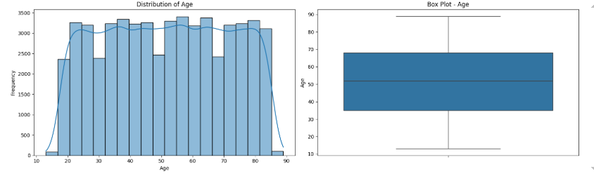
Variable Analysis
The following analysis results were exported in structured JSON format, enabling reproducibility and potential integration into downstream RAG or LLM workflows.
Age

Slide 8
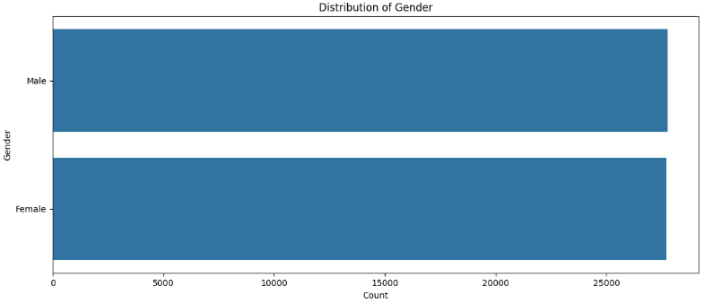
Variable Analysis
Gender

Slide 9
Variable Analysis Summary
Balanced & Uniform Data:
Patient profiles are evenly distributed across conditions, test results, age, and admission types—minimizing bias and class imbalance.
Weak Inter-Variable Correlations:
Low correlation across variables confirms absence of hidden dependencies—ideal for controlled experimentation and prototyping.
Stable Conditional Probabilities:
Minimal variation in abnormal test results and emergency admissions (~1–2%) suggests consistent behavior, though less reflective of real-world disparities.
High Provider Diversity:
Over 40k doctors and 39k hospitals with low repeat assignments—supports testing decentralized triage logic.
Conclusion:
The dataset is synthetic but well-structured—perfect for early-stage NLP model training, multi-class classification, and workflow automation without confounding noise.

Slide 10
Variable Analysis Summary
Balanced & Uniform Data:
Patient profiles are evenly distributed across conditions, test results, age, and admission types—minimizing bias and class imbalance.
Weak Inter-Variable Correlations:
Low correlation across variables confirms absence of hidden dependencies—ideal for controlled experimentation and prototyping.
Stable Conditional Probabilities:
Minimal variation in abnormal test results and emergency admissions (~1–2%) suggests consistent behavior, though less reflective of real-world disparities.
High Provider Diversity:
Over 40k doctors and 39k hospitals with low repeat assignments—supports testing decentralized triage logic.
Conclusion:
The dataset is synthetic but well-structured—perfect for early-stage NLP model training, multi-class classification, and workflow automation without confounding noise.

Slide 11
Medical Referral Letter Generation
Objective
Generated 5,000 realistic medical referral letters by combining AI text generation with the Faker library to reflect authentic Canadian healthcare data.
Implementation
Used GPT-2 for natural medical language generation
Integrated Faker (Canadian locale) for realistic names and hospital locations
Applied healthcare statistics to reflect accurate patient and condition distributions
Developed specialist assignment logic based on medical conditions and patient profiles
Dataset Features
5,000 unique referral letters in professional medical format
16 specialist categories as ground truth labels
Letters uniformly addressed as “Dear Colleague” to avoid classification bias
Average letter length: 582 characters, covering 6 medical conditions
Quality Assurance
Condition and specialist distributions aligned with real-world statistics
Generated authentic Canadian names and healthcare facilities
Implemented robust error handling for consistent output quality

Slide 12
BioClinical BERT with K-Fold Cross-Validation
Objective:
Predicted medical specialties from referral letters using BioClinical BERT, optimized for Google Colab.
Implementation Summary:
Used BioClinical BERT with a custom classification head.
Applied K-Fold Cross-Validation for robust performance evaluation.
Executed training on Google Colab with GPU and TPU acceleration.
Incorporated memory optimization, early stopping, weighted sampling, and real-time progress tracking.
Key Features:
Performed domain-specific text preprocessing.
Addressed class imbalance through weighted sampling.
Employed gradient accumulation and focal loss for stable training.
Produced confidence intervals and downloadable evaluation reports.
Outcomes:
Delivered a reliable, production-ready referral classification model with validated accuracy and thorough performance analysis.

Slide 13
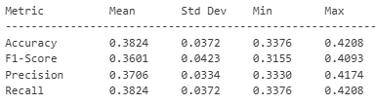
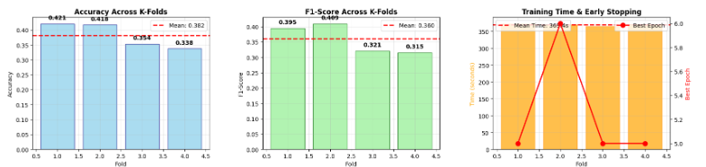
Final Model Performance
The BioClinical BERT model for medical specialist prediction achieved the following results across 4-fold cross-validation:

Slide 14
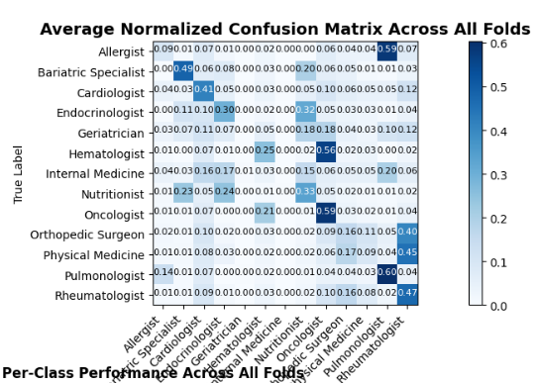
Final Model Performance

Slide 15
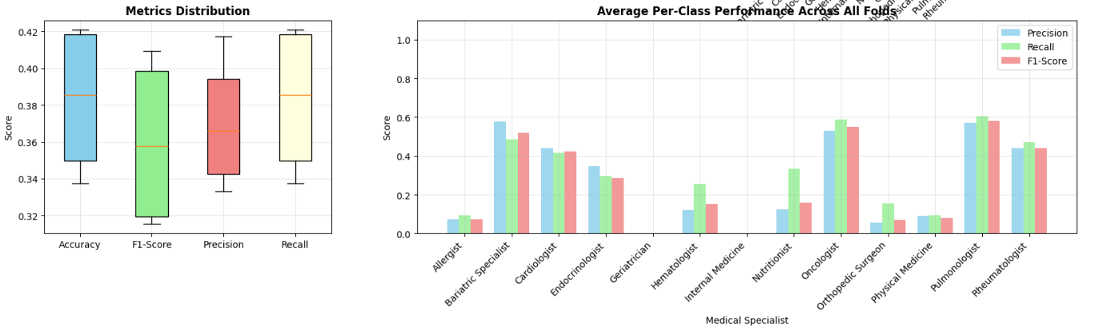
Final Model Performance

Slide 16
Project Limitations & Challenges
Part 1: Healthcare Data Analysis:
Small synthetic dataset (10,000 records) limited complexity
Correlation analysis unable to capture non-linear patterns
No temporal or longitudinal patient context
Part 2: Referral Letter Generation
GPT-2 occasionally produced repetitive or implausible content
No clinical validation of generated letters
Rule-based specialist assignment lacked real-world nuance
Part 3: BERT Classification
Colab GPU memory constraints limited model capacity and batch size
Long training times restricted hyperparameter tuning
Class imbalance persisted despite mitigation
BioClinical BERT pushed computational limits
Key Technical Challenges
Frequent memory issues required mixed precision and gradient accumulation
Model convergence needed fine-tuned early stopping
Medical text required custom preprocessing
Difficulties balancing precision and recall across classes
Future Work
Incorporate real clinical data for validation
Test advanced models (GPT-4, Claude, domain-specific transformers)
Conduct bias and fairness evaluations with healthcare partners

